Slide 1
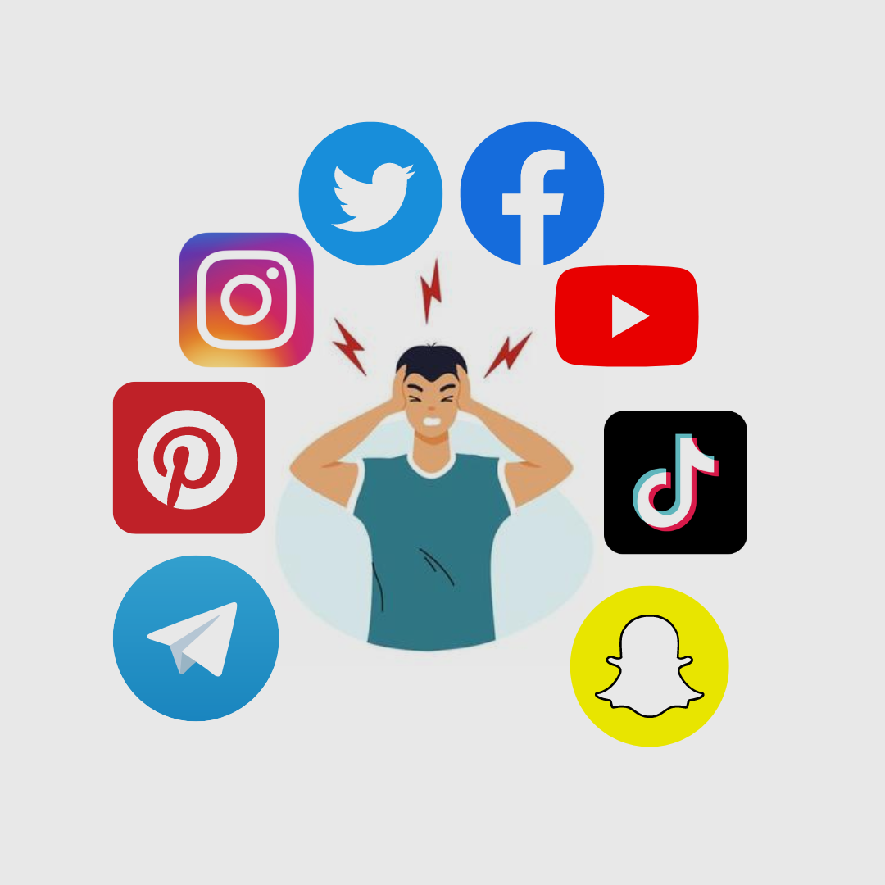
Social Media and
Mental Health
Project 1 Data Analytics
& Visualization
Notes:
JEFF

Slide 2
Project Information
Project Team: Group 1 - Dominic Thomas, Jeff Neal, Karina Gonzalez, Angelie Wanner
Project Scope: Our group decided to analyze whether social media platforms has any effect on mental health.
Attributes Analyzed: - Age - Hours per day (time spent on social media) - Mental health score Source of data: kaggle.com Social Median and Mental Health csv file – survey taken in 2022 (over 6 month period) https://www.kaggle.com/datasets/souvikahmed071/social-media-and-mental-health
Notes:
JEFF

Slide 3
Questions
1. Does social media have a detrimental impact on mental health?
2. Which social media platform is considered the most chaotic?
3. Is there a discernible correlation between the age groups using social media and their mental health status?
Notes:
JEFF

Slide 4
Scored Questions from Survey (1-5)
9. How often do you find yourself using Social media without a specific purpose?
10. How often do you get distracted by Social media when you are busy doing something?
11. Do you feel restless if you haven't used Social media in a while?
12. On a scale of 1 to 5, how easily distracted are you?
13. On a scale of 1 to 5, how much are you bothered by worries?
14. Do you find it difficult to concentrate on things?
15. On a scale of 1-5, how often do you compare yourself to other successful people through the use of social media?
16. Following the previous question, how do you feel about these comparisons, generally speaking?
17. How often do you look to seek validation from features of social media?
18. How often do you feel depressed or down?
19. On a scale of 1 to 5, how frequently does your interest in daily activities fluctuate?
20. On a scale of 1 to 5, how often do you face issues regarding sleep?
Notes:
JEFF

Slide 5
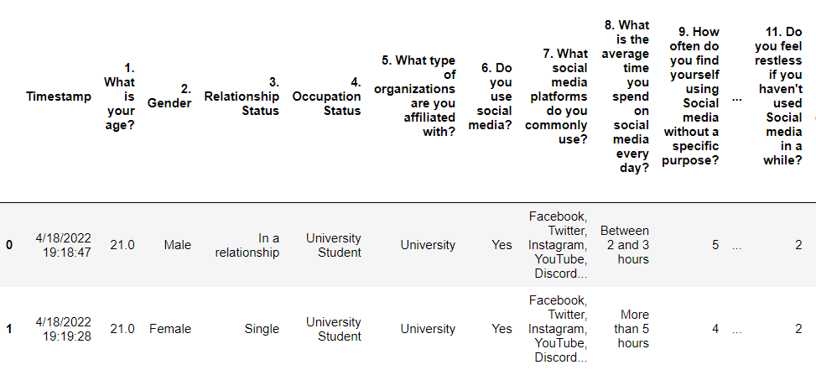
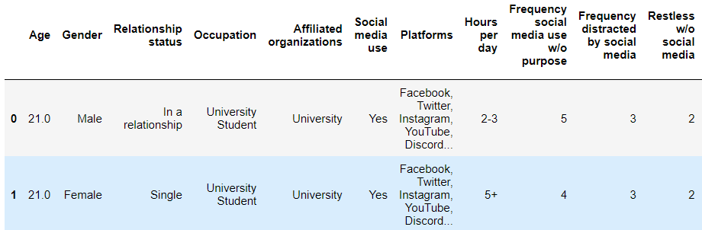
Data Cleanup
Removed Timestamp column
Before:
Shortened/renamed columns
Shortened/renamed hour ranges
0-1, 1-2, etc.
After:
Notes:
Python code utilized to read in smmh.csv file as a pandas dataframe for cleaning before moving to the analysis and graphing process. Python code was utilized to remove erroneous columns, shorten and rename columns, and redefine hour ranges for sorting purposes later in analysis and graphing. Null values were then identified and replaced to preserve number of available data points for later use. Spelling errors were corrected and duplicates were located and consolidated. Lastly, python code was utilized for preparation of the data set by creating new columns based off of the sum of questionnaire scored responses and binned grouping based off of survey participant age.

Slide 6
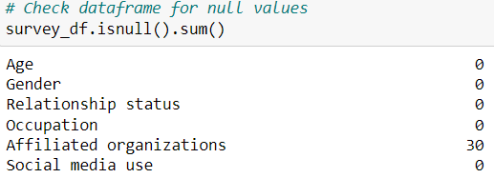
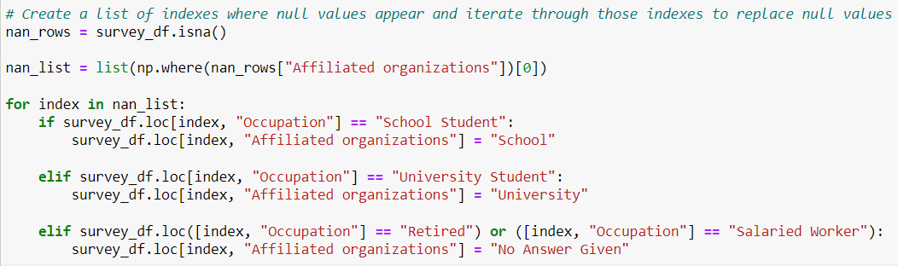
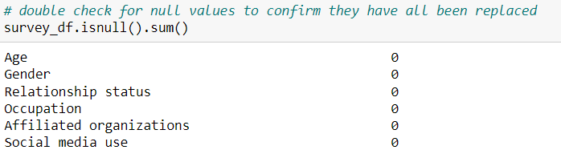
Replace Null Values
Notes:
DOMINIC

Slide 7
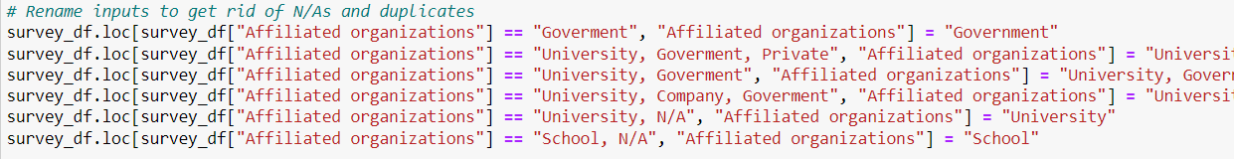

Consolidate Duplicates
Notes:
DOMINIC

Slide 8
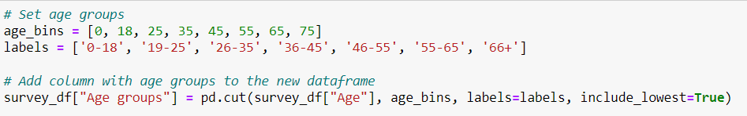
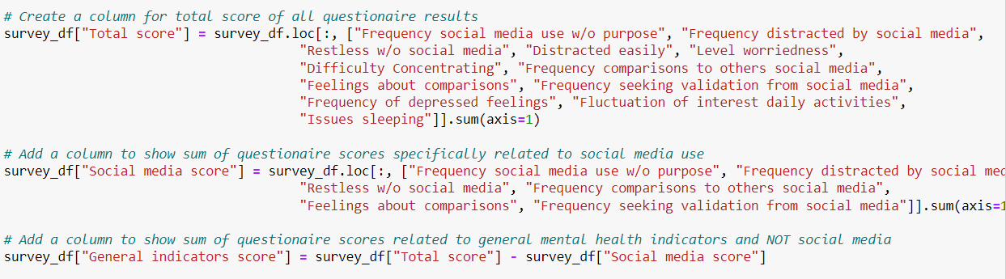
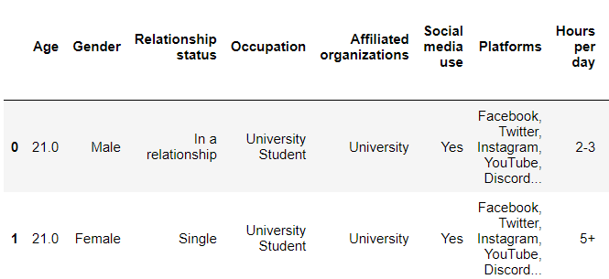
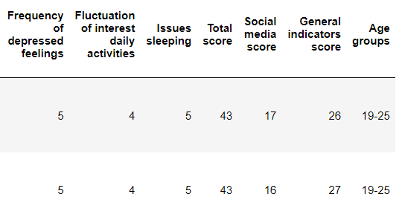
Data Preparation
Summed questionnaire scores into a total score column (12-60)
Created binned age groups
Notes:
DOMINIC

Slide 9
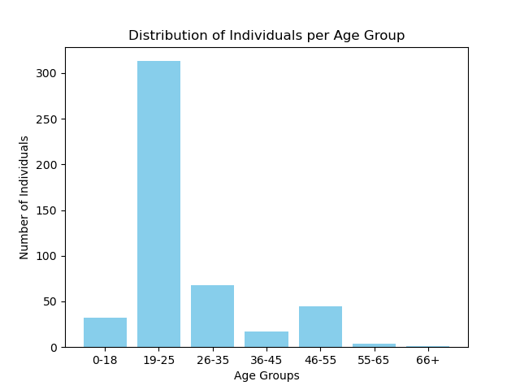
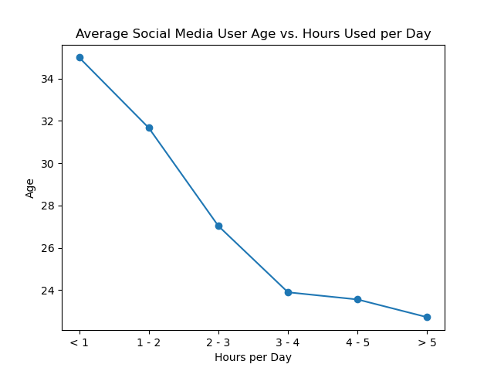
Distribution of individuals per age group and average hours spent on social media per day; indicating that younger individuals spend more hours on social media per day.
Notes:
Karina
With a small csv file the data we have shows that the majority of social media users are ages 19-25 and starts decreasing with age
According to the chart it shows that with higher age the hours an individual is on social media starts to decrease

Slide 10
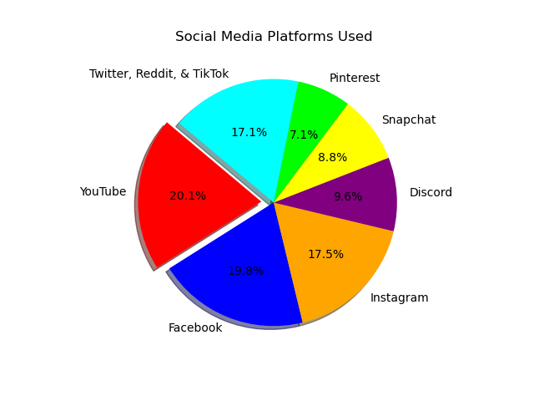
Of the platforms used by participants, YouTube is the most widely used followed by Facebook. Twitter, Reddit, TikTok and Instagram were not far behind.
Facebook
Connect with friends, family and acquaintances
Twitter
Post short messages of your thoughts online
YouTube
Video sharing platform
Instagram
Photo and video sharing platform
TikTok
Short-form video content, often with music, stories, comedy or challenges
Discord
Digital clubhouse primarily for gamers
Snapchat
Messaging app to send photos and videos that disappear
Reddit
Discussion platform
Pinterest
Digital bulletin board or scrapbook
Notes:
Karina
YouTube was shown to be the most used platform at 20.1% while Pinterest was only used at 7.1%.
Twitter, Reddit and TikTok were used at a combined amount of 17.1% due to being used less separately

Slide 11
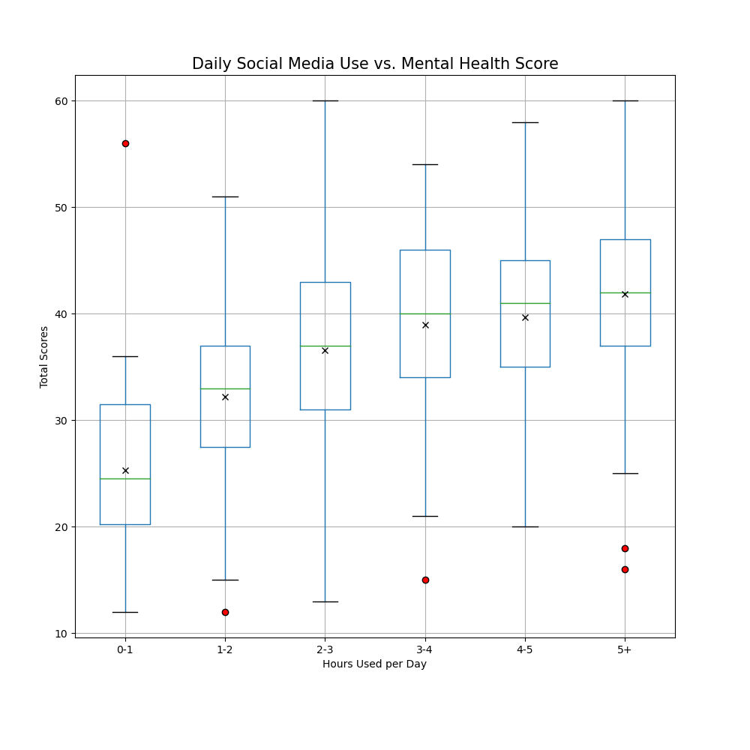
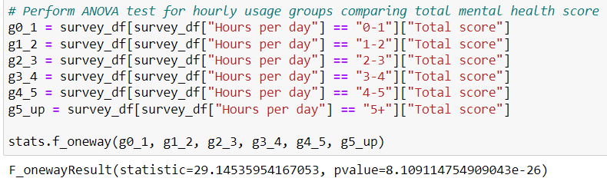
Social Media Hours vs. Mental Health Score
ANOVA results suggest a significant difference in average mental health scores across the six observed hourly usage ranges.
Notes:
Python code utilizes boxplots to visualize the relationship between average self reported total mental health scores against hours of social media used daily. The boxplot shows few outliers in the 0-1, 1-2, 3-4, and 5+ hourly ranges. The boxplot also displays an upward trend in median and average mental health scores as time spent on social media increases. Python code performs an ANOVA test on hourly ranges of daily social media use by total mental health scores, resulting in a p-value of 8.11e-26 which shows significant difference mental health scores between hourly usage across the data set. Python code then splits the total survey data frame between daily hour usage below 4 hours and above 4 hours and performs a two sample t-test on these two groups to look for significant difference between mental health scores. The resulting p-value of 2.81e-13 confirms that a significant difference in mental health scores between the two divisions of the dataframe is present. The python code then calculates the exact percent increase between average mental health score of users in the 0-4 hour daily social media usage range compared to those using social media for 4+ hours daily with the resulting percent increase noted at 17.23%.

Slide 12
T-test Results - Hours Used vs. Scores
Suggested significant difference in self-reported mental health scores between users who are on social media 0-4 hours per day versus 4+ hours a day.
Notes:
DOMINIC

Slide 13
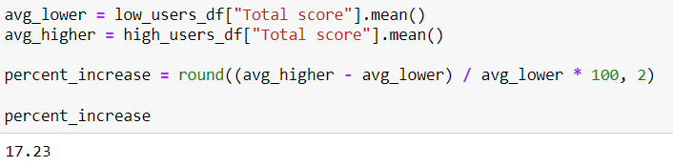
Percent Increase in Mental Health Score
There is a 17.23% increase in average total self reported mental health score between use of social media for 0-4 hours daily and use of social media for greater than 4 hours a day.
Notes:
DOMINIC

Slide 14
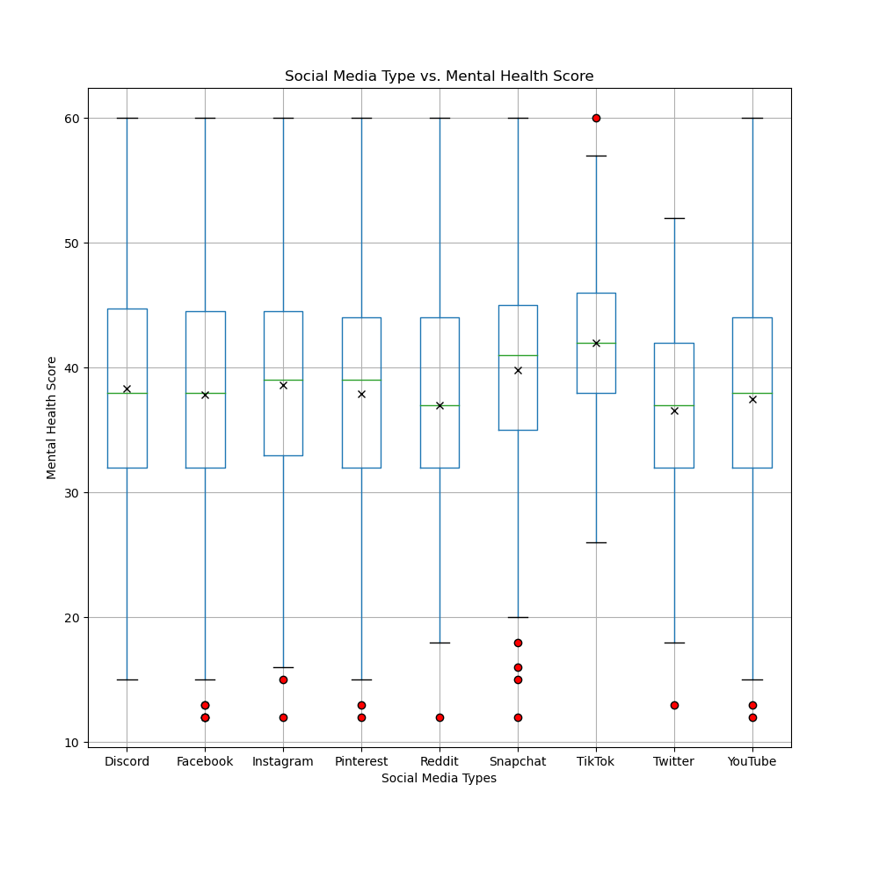
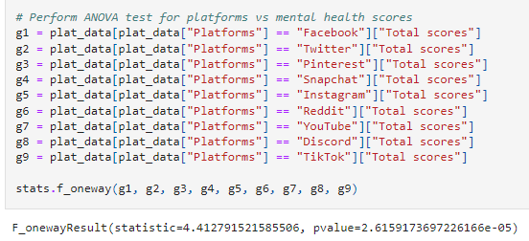
Social Media Type vs. Mental Health Score
Each social media platform contains different forms of content for the viewer to engage in. Depending on the content, it could result in different mental scores and help determine which platform is considered the more “chaotic”.
P value = 2.6159173697226166e-05
Notes:
Karina
Majority of outliers are on the lower ends of the mental health scores for each social media platform.
TikTok was shown to be the only one to have the highest mental health score outlier which shows us that it causes more mental health issues than the other platforms.
Discord is also the only platform that has no outliers and the only one that seems to be more stable than the rest which can also indicate it’s the least chaotic.

Slide 15
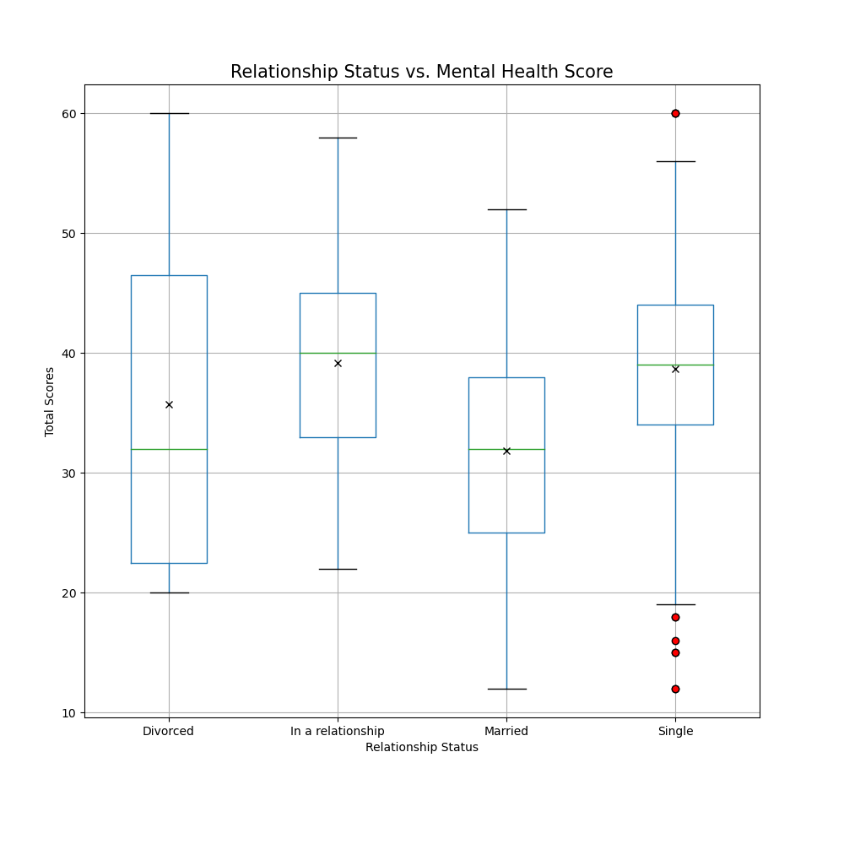
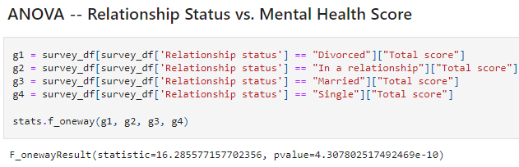
Relationship Status vs. Mental Health Score
Relationship status was shown to take a significant part in how many hours a person was using social media.
P value = 4.307802517492469e-10
Notes:
Karina
Relationship status was shown to take a significant part showing all the outliers on only single individuals.

Slide 16
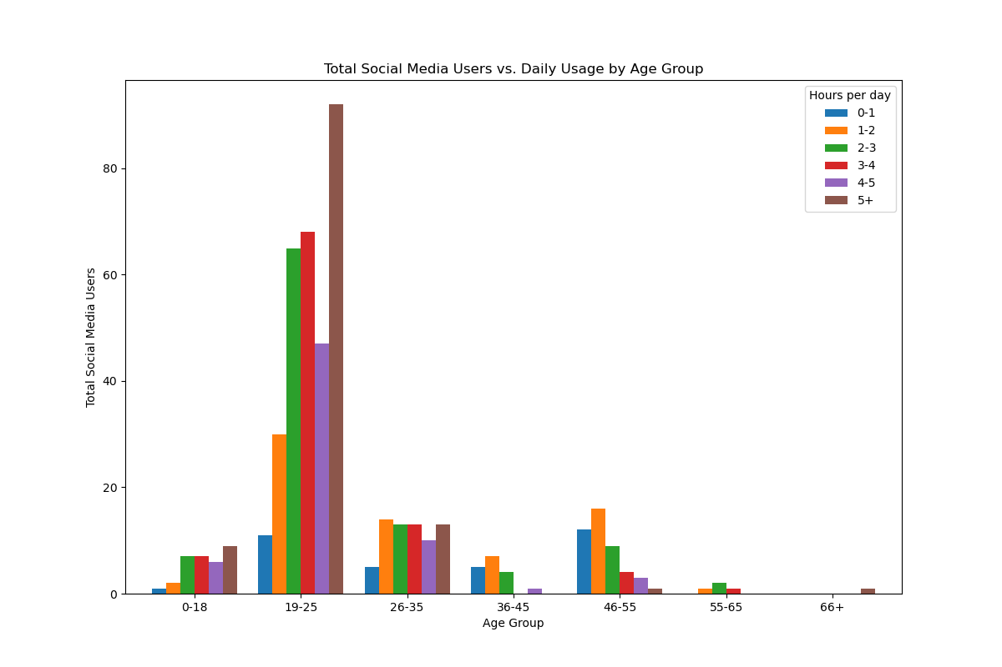
Distribution of Users by Age Group & Hours Used
Notes:
Karina
Most users are ages 19-25
The data is unevenly distributed
Older you get the less hours and the lower the total score

Slide 17
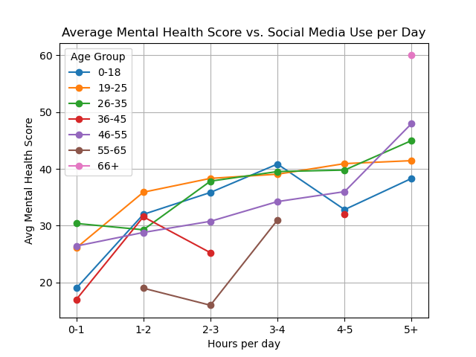
Hours on Social Media by Age
Majority of social media users were between the ages of 19-25. Most of this age group spend their free time going out and posting or scrolling on social media since majority are still in school or starting careers.
Usually the age group <18 is normally too young for social media, their parents are limiting their platforms or they’re viewing more family friendly content
P value <18 = 0.051761765743704016
P value 19-25 = 2.3759313125091938e-08
The second highest social media users were the ages 26-35. Usually this age group starts limiting their use of social media due to personal life events which cause less hours on their devices.
This age group today are still learning social media platforms. Most still rather choose to stay off social media entirely.
P value 26-35 = 0.0002816233170514804
P value 36-55 = 0.045473711051482735
Notes:
Karina

Slide 18
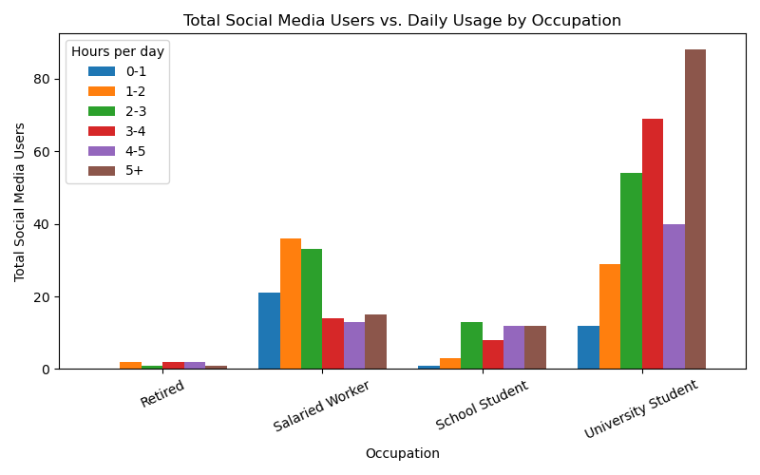
Occupation vs Hours per Day
The dataset provided contains information about the social media usage of individuals across various occupations. It captures the engagement levels of each occupation which includes, Retired individuals, Salaried Workers, School Students, and University Students.
Notes:
JEFF

Slide 19
Limitations
Data availability! We found an abundance supply of articles discussing social media and its effects on mental health, but there were limited raw data available for use.
Small dataset! There wasn’t a wide range of age distribution, majority of the participants were between 19-25 years of age.
Scores are relative! Scores are self reported which allows for more variability from person to person.
Time! For data we did find, we didn’t have enough time to adequately analyze. The datasets were not easily readable and required time to clean up in order for it to be in a digestible format.
Notes:
Angelie

Slide 20
Conclusion
Conclusive evidence shows us that there is a correlation between time spent on social media and overall mental health score reported by individuals.
The null hypothesis that spending at least 4 hours on social media does not have a high effect on individuals and their mental health was disproven. Although it didn’t meet our hypothesis that it would be a 30% increase in self-reported mental health, there was still a notable increase between users who spent less than 4 hours and those who spent more than 4 hours a day on social media platforms.
Notes:
Angelie

Slide 21
Additional Analysis
If we had more time….
Dive deeper on differentiation between individuals that presented mental health symptoms due to social media and those that presented symptoms with no influence from social media
We saw some indication of less mental health symptoms from individuals who were in a relationship than single, but still spent the same amount of time
How does content viewed affect individual’s mental health? Does it change dependent on platforms?
Notes:
Angelie

Slide 22
Thank you!
Questions?

